Slide 1
Cyber Threats and Their Prevention
Introduction
Mudasani Rushikesh
Significance
Pikala Ritwik Durga
Challenges
Seemakurthi Nandan Sri Siva Ramakrishna
Existing Approaches
Ogireddy Sudeep
Future Scope and Open Problems
Permulapalli Srinivasa Aditya

Slide 2
Introduction

Slide 3
Introduction to Cyber Threats
Definition: Cyber threats refer to malicious activities that target computers, networks, or information systems to steal, alter, or destroy data or disrupt digital operations.
Importance: In the digital age, cyber threats have become a critical concern for individuals, businesses, and governments due to the increasing reliance on digital infrastructure.

Slide 4
Evolution of Cyber Threats
Early Cyber Threats (1970s - 1990s):Initial threats were relatively unsophisticated, such as simple viruses and worms.
Motivations were often curiosity, experimentation, or mischief.

Slide 5
Types of Cyber Threats
Denial of Service (DoS) and Distributed Denial of Service (DDoS) Attacks: Overwhelming a service or network to make it unavailable to its intended users.
Man-in-the-Middle (MitM) Attacks: Intercepting and manipulating communication between two parties without their knowledge

Slide 6




Types of Cyber Threats

Slide 7


Types of Cyber Threats
Advanced Persistent Threats (APTs): Prolonged and targeted cyber attacks where the intruder remains undetected for a long period.
Insider Threats: Malicious or negligent actions by trusted insiders, such as employees, that compromise security.

Slide 8
Rise of Organized Cybercrime (2000s - Present):Increased sophistication in attacks, involving organized crime groups.
Cyber threats began focusing on financial gain, including credit card fraud, identity theft, and ransomware.
Present day scenario
State-Sponsored and Hacktivist Groups (2000s - Present):Emergence of state-sponsored actors targeting other nations for espionage or sabotage.
Hacktivists use cyber attacks to promote political agendas or social causes.

Slide 9
Significance

Slide 10
Impact of Cyber Attacks on Individuals
Loss of Productivity and Opportunities
Disruption of daily activities due to ransomware/denial-of-service.
Missed opportunities and professional setbacks.
Damage to Reputation and Relationships
Blackmail, defamation, and social engineering attacks.
Rebuilding trust in personal and professional circles is challenging.
Emotional Distress and Anxiety
Privacy violation leads to heightened anxiety.
Fear and loss of trust in digital platforms.
Financial Loss and Identity theft
Drained bank accounts, unauthorized purchases.
Long-term financial instability and identity theft.

Slide 11
Impact of Cyber Attacks on Organizations
Loss of Reputation
Erosion of client trust due to data breaches.
High-profile examples: Equifax, Target, J.P. Morgan Chase.
Systems often shut down until resolution or restoration.
Loss of Revenue
Financial strain from downtime, ransom payments, data recovery.
Average cost for SMBs: $117,000 per data breach (Kaspersky).
Additional expenses: customer notification, credit monitoring, regulatory penalties.
Loss of Productivity
Operations halted due to malware/ransomware.
Example: Colonial Pipeline attack in May 2021.
Systems often shut down until resolution or restoration.

Slide 12
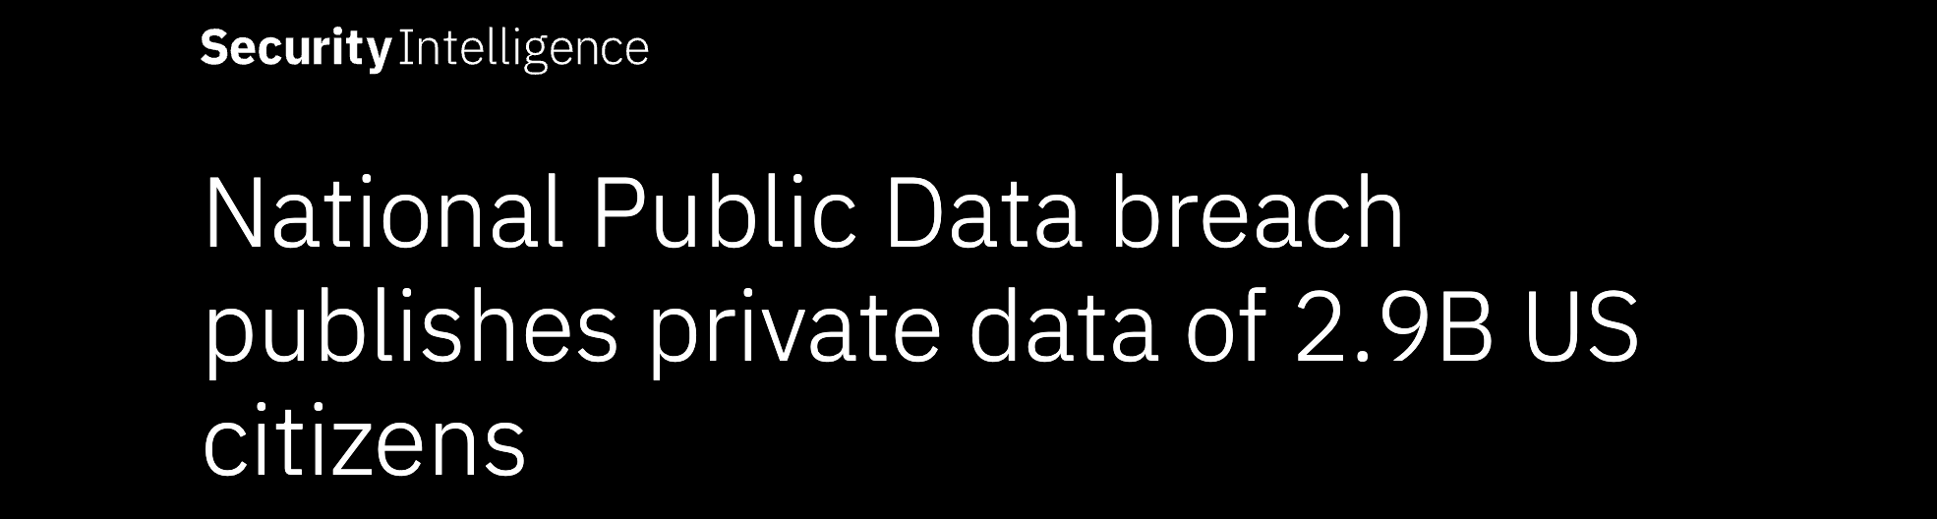
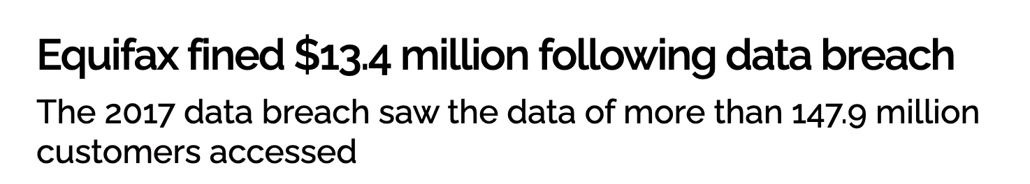
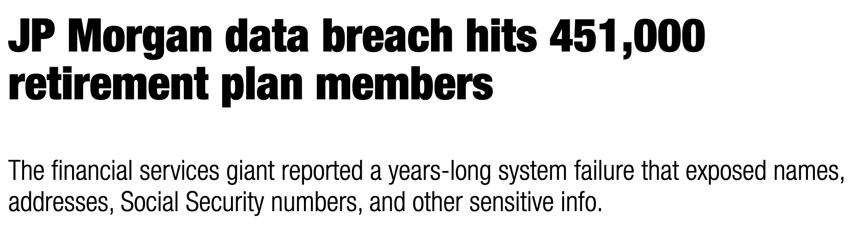
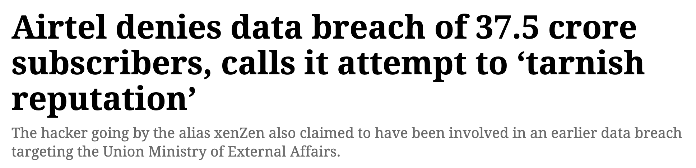
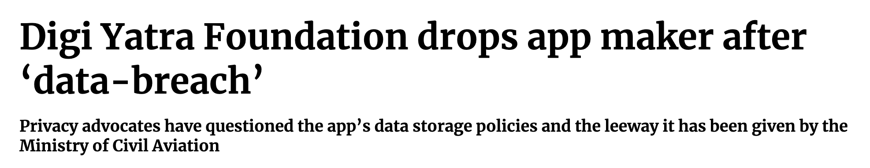
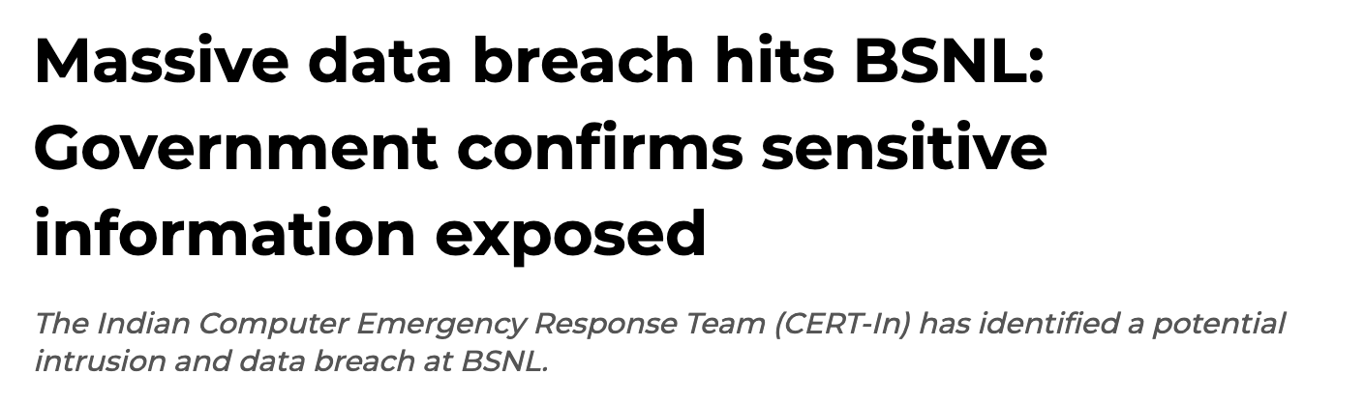
Source: Security Intelligence
Country: US
Year: 2023
Source: Cybersecurity Hub
Country: US
Year: 2017
Source: The Hindu
Country: US
Year: 2023
Source: The Indian Express
Country: India
Year: 2024
Source: The Hindu
Country: India
Year: 2024
Source: The Financial Express
Country: India
Year: 2024

Slide 13
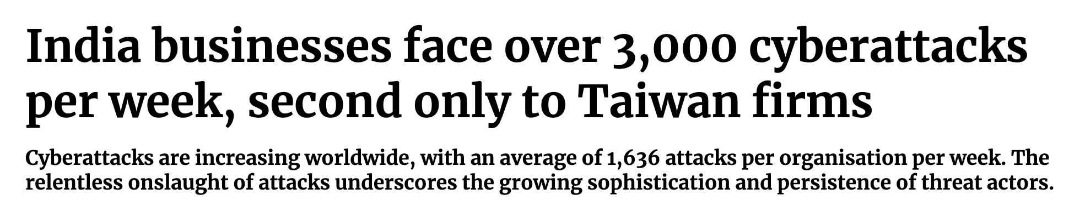
Several cyber threat trends are happening simultaneously. For instance, the education and research industry has consistently been a prime target for cybercriminals
India-based organisations recorded the second-highest number of weekly attacks per organisation in Q2 2024. This marked a 46% year-over-year increase in cyberattacks, compared to 30% witnessed globally.
Government/Military was the second most attacked sector with 2,084 attacks per week
Healthcare emerged as the third most targeted sector.

Slide 14
Economic Impact of Cyber Attacks
Global Economic Impact
$6 Trillion USD in damages globally in 2021.
Projected to reach $10.5 Trillion USD annually by 2025.
If cybercrime were a country, it would rank as the 3rd largest economy globally, after the U.S. and China.
The Ransomware Epidemic
2015: Ransomware caused $325 Million in damages.
2021: Reached $20 Billion in damages globally.
By 2025, a business could face a ransomware attack every 11 seconds.
Expanding Cyberattack Surface
By 2026, there will be 3X more networked devices on Earth than humans.
By 2025, More than 1 trillion networked sensors will be embedded worldwide, increasing vulnerability.
The rapid growth of IoT and cloud storage is broadening the attack surface exponentially.
Escalating Cybersecurity Spending
$1 Trillion USD in global spending on cybersecurity from 2017 to 2021
Projected 12-15% annual growth in the cybersecurity market through 2025.
Despite increased spending, cyber threats continue to outpace defensive measures.

Slide 15
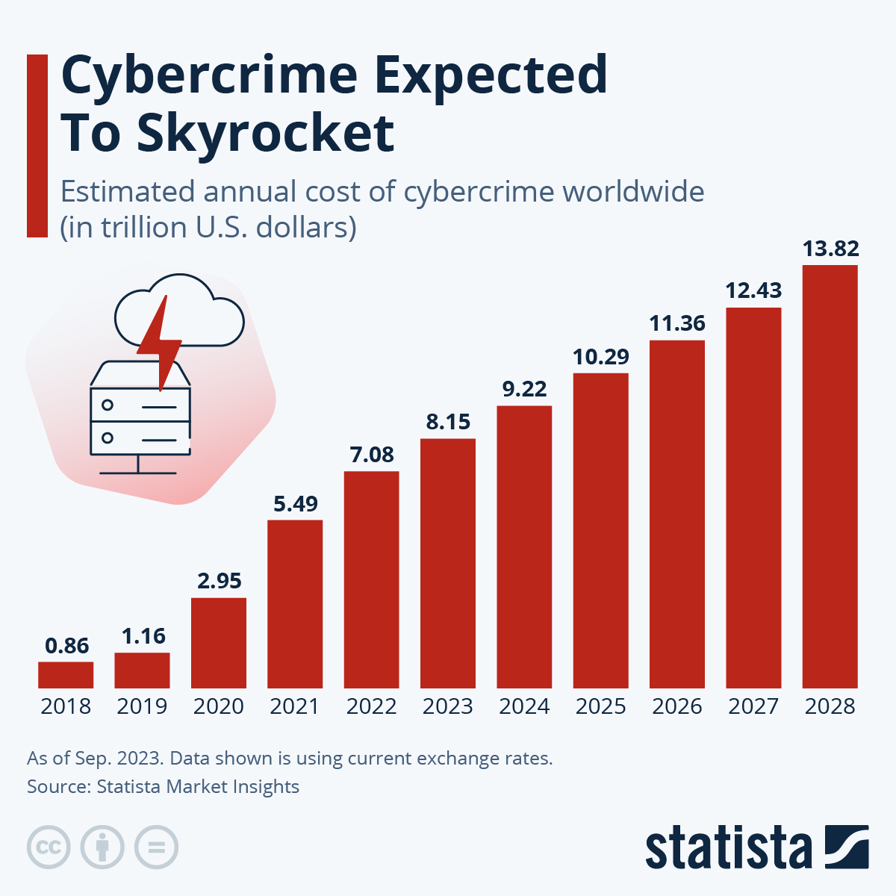
The cost of cybercrime has skyrocketed from $0.86 trillion in 2018 to an estimated $13.82 trillion by 2028.
Over the decade, the cumulative cost of cybercrime could exceed $90 trillion.
This highlights the growing importance of cybersecurity investment as a critical component of risk management.

Slide 16
Cybersecurity as National Priority
Importance
Protecting sensitive data
Ensuring national security
Maintaining economic stability
National Impact of Cyber Attacks
Disruption of critical infrastructure
Compromise of military operations
Influence on elections
Harm to businesses
Government Responsibilities
Enforcing stringent regulations.
Raising awareness about cybersecurity risks and best practices.
Invest in advanced cybersecurity technologies
Providing training and resources.
Support better cybersecurity policies.

Slide 17
Importance of Proactive Cybersecurity
Detect threats early to address vulnerabilities before they are exploited.
Implementing preventive measures can help reduce the risk of cyberattacks.
Continuously monitoring the systems for real-time threat assessment and quick response can be helpful.
Proactive measures build a stronger defence compared to reacting to incidents after they occur.

Slide 18
Challenges

Slide 19
Sophistication of Cyber Attacks
Advanced Techniques: Cybercriminals use AI, machine learning, and deepfake technology to make attacks more sophisticated and harder to detect.
Zero-Day Exploits: Attackers exploit unknown software vulnerabilities before they are patched, leaving little time for defence.

Slide 20
Volume and Speed of Attacks
High Frequency: Organizations face a constant barrage of attacks, often overwhelming their security defences.
Automation of Attacks: Cybercriminals use automated tools to launch large-scale, rapid attacks, increasing the challenge of timely detection and response.

Slide 21
Human Error and Lack of Awareness
Insider Threats: Employees can unintentionally compromise security through weak passwords, phishing scams, or other mistakes.
Lack of Training: Insufficient cybersecurity awareness and training make organizations vulnerable to simple yet effective attacks.

Slide 22
Resource and Budget Constraints
Cost of Security: Implementing and maintaining robust cybersecurity measures is expensive, often stretching budgets, especially for small and medium-sized businesses.
Shortage of Skilled Professionals: The cybersecurity field faces a significant talent gap, making it hard to find qualified personnel to manage and mitigate threats.

Slide 23
Evolving Regulatory Environment
Complex Compliance Requirements: Navigating various international, national, and industry-specific regulations is challenging and costly.
Legal Risks: Non-compliance with data protection laws can lead to severe penalties and damage to reputation, adding pressure to already strained resources.

Slide 24
Rapid Technological Change
Adapting to New Technologies: As organizations adopt new technologies (e.g., IoT, cloud computing), they must constantly update their security measures, which can be difficult and resource-intensive.
Legacy Systems: Many organizations still rely on outdated systems that are difficult to secure against modern threats.

Slide 25
Existing Approaches

Slide 26
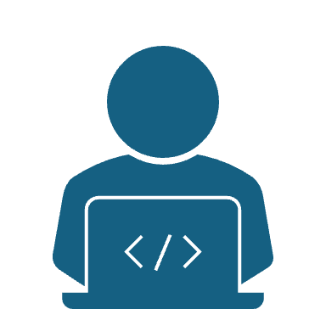
Current Methods To Avoid Cyber Attacks
Organizations use a variety of methods to protect against Cyber attacks.
These methods combine technology, policies and user awareness.

Slide 27
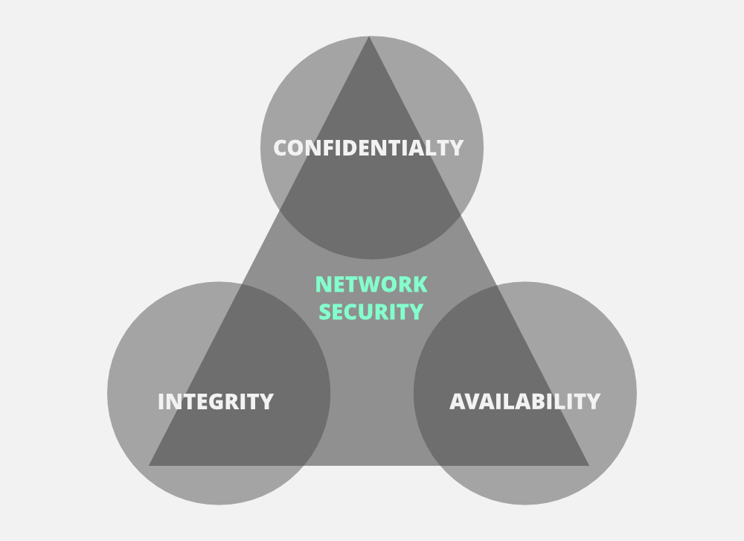
The CIA Triad
The CIA triad is a fundamental concept used by organizations to guide their policies to avoid/prevent cyberattacks.
The CIA triad is critical in designing, implementing, and managing secure information systems.

Slide 28

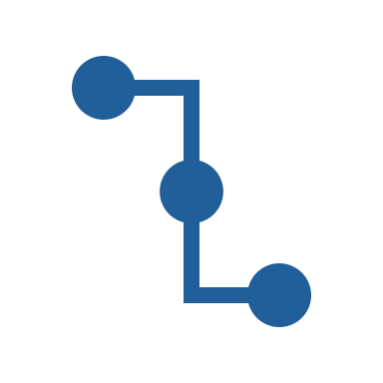
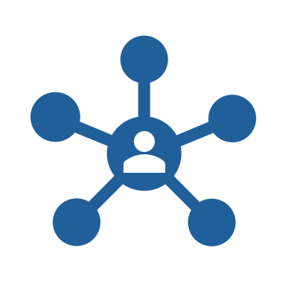
The CIA triad
Confidentiality: Only authorized users can access sensitive data, typically ensured through encryption and VPNs for secure data transmission.
Integrity: Data integrity is maintained by using hash functions to detect corruption by comparing hashes at both ends of the data transfer.
Availability: Network and services should be consistently accessible, with proactive maintenance and protection against DoS/DDoS attacks to prevent resource exhaustion.

Slide 29
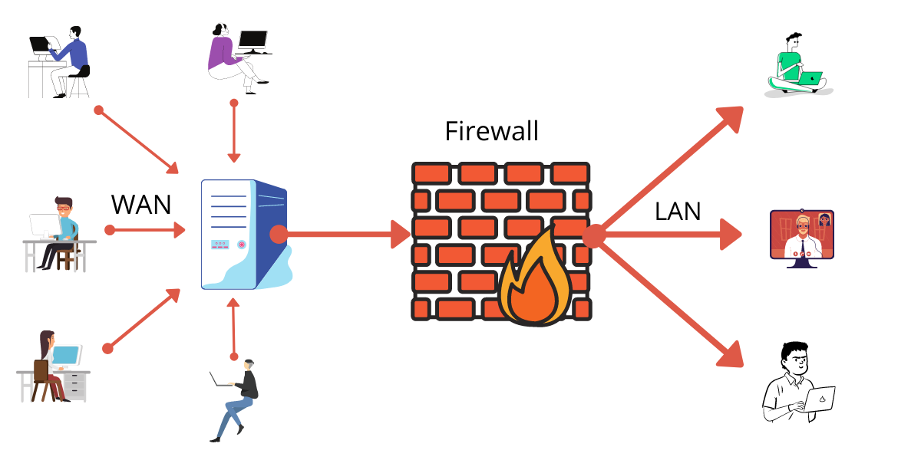
FireWalls
Network Barrier: Firewalls create a barrier between a trusted internal network and the untrusted internet.
Traffic Monitoring: They monitor and filter incoming and outgoing traffic based on predefined rules.
Access Control: Firewalls block unauthorized access while permitting legitimate communications by inspecting data packets.

Slide 30
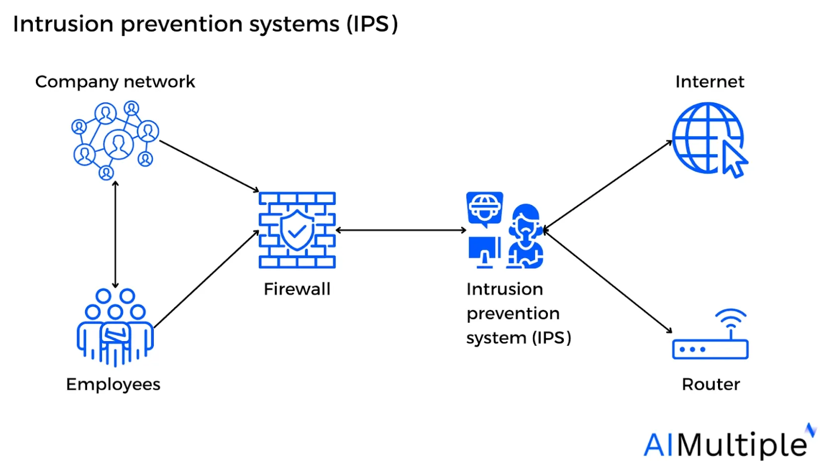
Intrusion Prevention and Detection Systems(IDPS)
IDPS monitors a network for possible threats to alert the administration, thereby preventing attacks
It is a bit different from firewalls, where here, it focuses on detecting and responding to suspicious activities.

Slide 31
Intrusion Prevention and Detection Systems(IDPS)
Security Alerts and Mitigation: Sends alerts for suspicious activity and, through IPS, mitigates threats in real-time.
Policy Compliance: Detects intrusions and identifies any gaps in user or company policies.
Network Monitoring: Gathers data on network traffic and resources for analysis.

Slide 32
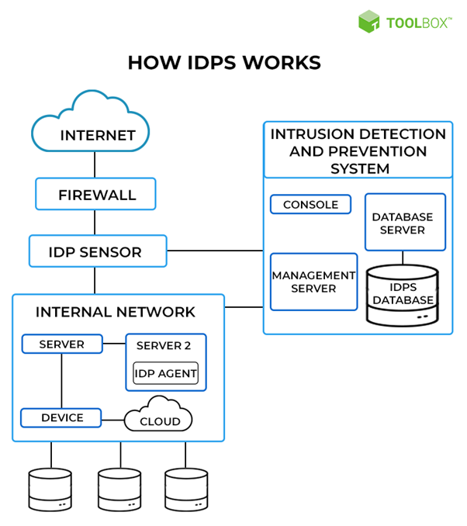
Techniques of IDPS:
Signature-based Detection: Detects attacks by matching activities to known signatures. New signatures are added when identified, but unknown malware may go undetected.
The other technique is anomaly-based detection: Anomaly-based Detection: Flags deviations from normal behavior to identify new threats, though it often generates false positives.

Slide 33

Prevention Actions:
Alert Administrators: This is the most basic type of response. Once an intrusion is detected, an alert is raised to be handled by the administrator.
Banishment Vigilance: When IDPS detects repeated suspicious activity, it tries to stop the activity by blocking the source of the activity.

Slide 34
Prevention Actions:
Change Security Environment: Similar to banish vigilance, IDPS tries to change the security setup to prevent the threat from gaining access. Like reconfiguring a firewall.
Change the content of the attack: For example if an email is flagged IDPS might remove any malicious aspect of the email like attachments.

Slide 35
User based preventions
Use Strong Passwords
Enable 2 Factor Authentication
Limit Sharing of Personal Information on Social Media.
Use Anti-Virus and AntiMalware Softwares.
Update Softwares Regularly
Be Cautious with Emails.

Slide 36
Future Scope and Open Problems

Slide 37
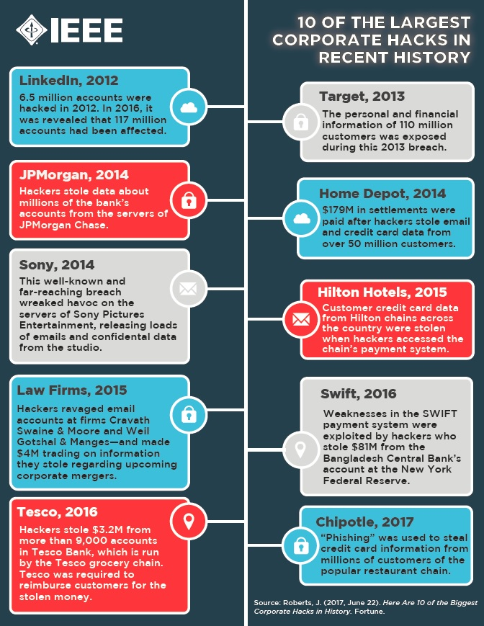
Open Problems :
Cybersecurity is a rapidly evolving field with a constant cat-and-mouse game between security professionals and cybercriminals. While many challenges have been addressed, several unsolved problems and emerging threats persist.

Slide 38
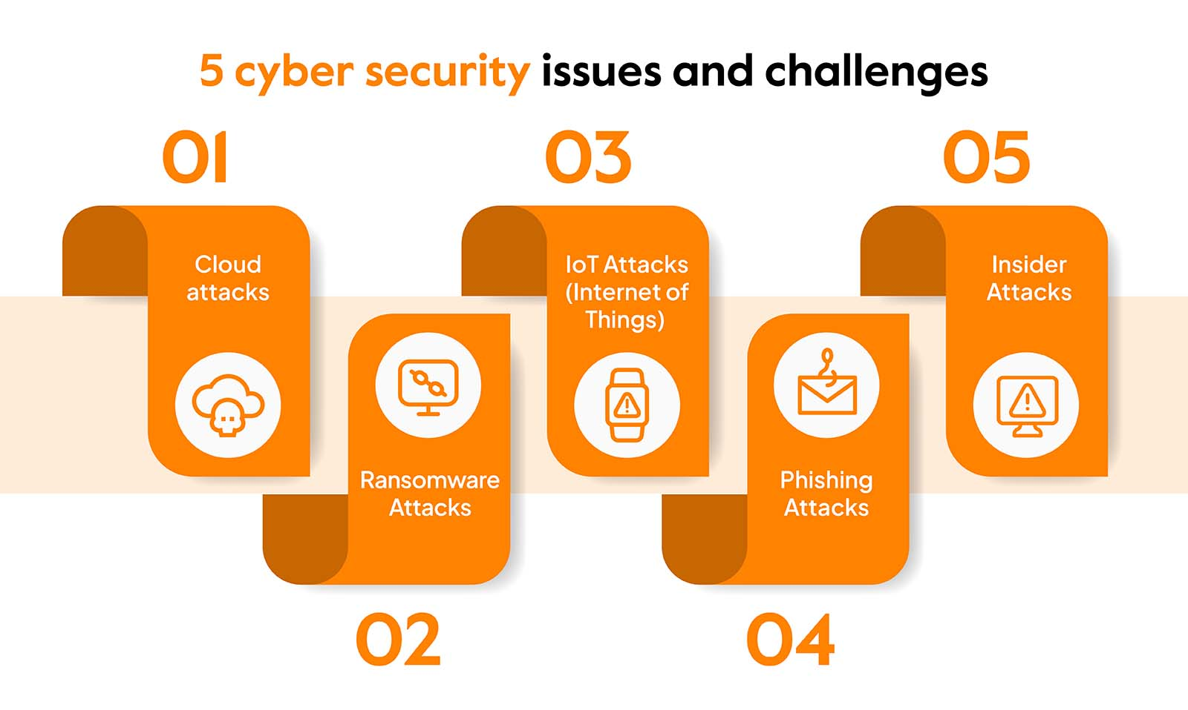

Slide 39
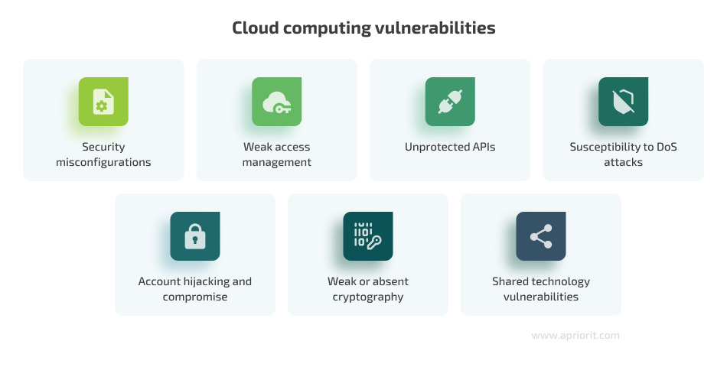
Cloud Attacks
Cloud cyber attacks have become a significant concern for organizations leveraging cloud computing services. Bad people try to trick or break into cloud computers to steal information or cause problems. This can happen when they find weak spots in the cloud system, the programs it runs, or the accounts people use.
Source: Apriorit

Slide 40
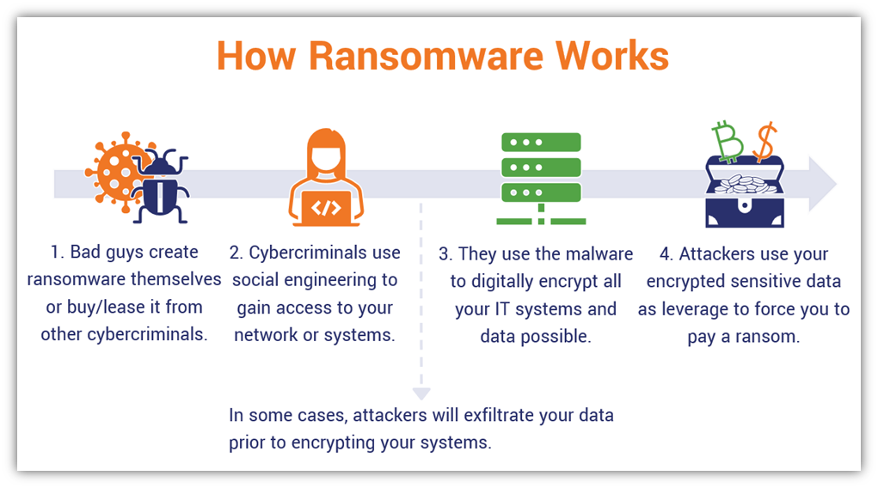
Ransomware Attacks :
Ransomware is a really bad type of computer virus. It locks your files or computer and asks you to pay money to get them back. Bad people do this to steal your important stuff like personal information, money details, or secret work things.
Ransomware can spread quickly and affect lots of computers at once. There's no easy way to stop ransomware. Even if you have good security, it can still happen. New types of ransomware are always coming out.
So, it's important to be careful and know about ransomware.

Slide 41

Internet of things(IOT) Attacks
The Internet of Things (IoT) is like a bustling digital bazaar where gadgets—ranging from voice controllers to smart locks—gather to exchange data .As the Internet of Things (IoT) continues to grow, securing billions of interconnected devices with varying levels of security poses a significant challenge.
Future security efforts must focus on developing comprehensive protections to address these growing risks and safeguard the IoT landscape.

Slide 42
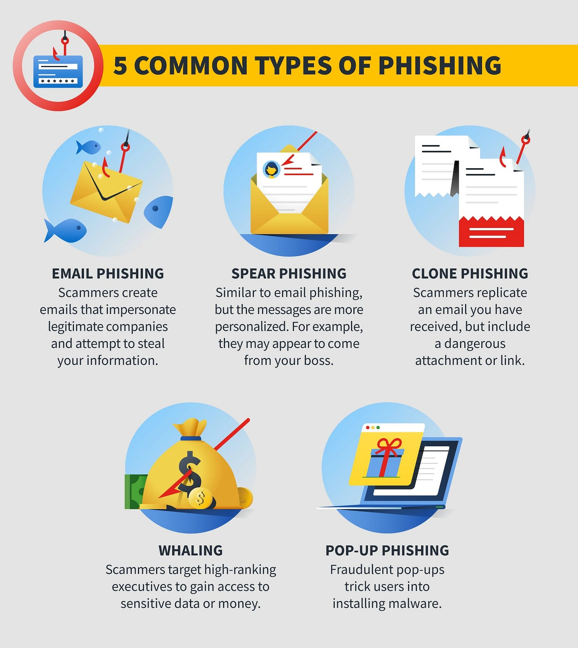
Phishing :
Phishing is a trick used by bad people to steal your information. They pretend to be someone you trust (like your bank or company) to trick you into clicking on bad links or giving them your passwords. This can lead to your computer getting locked up or your personal information being stolen.
To protect yourself, it's important to keep your software updated, use good security tools, have strong passwords, continuos monitoring and evaluation and teach people about how to spot phishing emails.

Slide 43
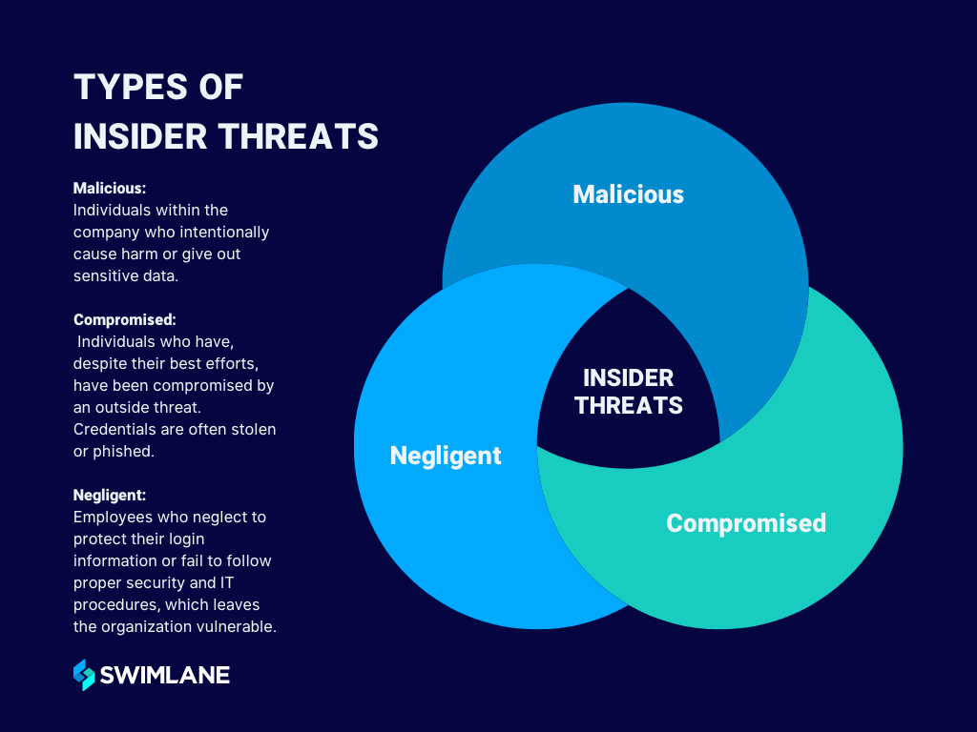
Insider Attacks :

Slide 44
The Future of Cybersecurity :
Evolving Cybersecurity Landscape. As technology advances, so do cyber threats. Traditional security measures are becoming increasingly inadequate to protect against sophisticated attacks.
AI & ML in Cyber Defense. These technologies can help detect and respond to threats more effectively, analyze vast amounts of data, and predict potential attacks.
Quantum Computing Impact. While it can enhance the capabilities of defenders, it also has the potential to break current encryption methods, making it a double-edged sword.
Tech Advancements & Vulnerabilities. As outdated systems are replaced, new security challenges arise, requiring continuous adaptation and vigilance.
Sophisticated Cyber Threats. Attackers are leveraging advanced techniques like artificial intelligence, social engineering, and supply chain attacks to breach defenses.
Adapting Cybersecurity Practices. This includes adopting proactive security measures, fostering a strong security culture, and investing in ongoing training and education.

Slide 45
References
https://www.geeksforgeeks.org/the-cia-triad-in-cryptography/
https://www.spiceworks.com/it-security/vulnerability-management/articles/what-is-idps/
https://www.redhat.com/en/topics/security/what-is-an-IDPS
https://www.checkpoint.com/cyber-hub/cyber-security/what-is-cybersecurity/
https://www.nist.gov/cyberframework
https://www.geeksforgeeks.org/cyber-security-types-and-importance

Slide 46
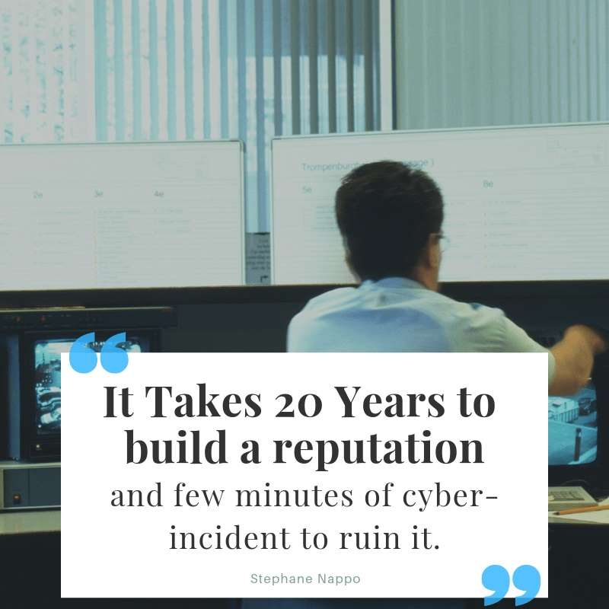
Thank you

